Slide 2

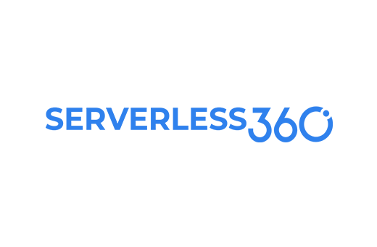



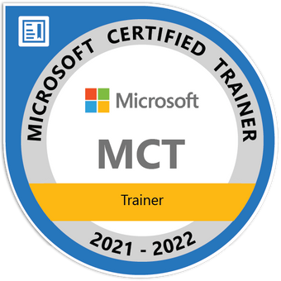
Ezhilarasi Chezhiyan
Lead Product Consultant | |

Slide 3
The Power of Azure Enterprise Integration Platform
Let’s Explore!

Slide 4
Exploration plan
Fundamentals
3 Real time scenarios
Azure Services that fit into business needs
The Azure implementation
Operational challenges to be aware of
Solution to achieve Operational Excellence

Slide 5

Azure Enterprise Integration Platform
Integration Account
Cost Analysis
Front Door
Security Centre
Logic Apps
Logic Apps
Data Factory
Integration Account
Logic Apps
API Management
Azure Functions
Key Vault
Data Transformation
EAI
API
ETL & ELT
B2B Integration
System Workflow
Application Configuration
Integration Services Environment
Event Grid
Storage
Azure Functions
Application Insights
Event Hub
Azure SQL DB
Enterprise Connectors
Power Automate
Data Gateway
Logic App
Inline Code
Service Bus
Cosmos DB
App Service
Plan
Log Analytics
Messaging & Events
Helper Functions
Storage
Enterprise Scenarios
Hybrid
Human Workflow
Azure Monitor
Infrastructure
Application Lifecycle
Pipelines
Testing
DNS Zones
Virtual Network
Private Link
Private Endpoints
Network Security
Groups
Management &
Monitoring
Boards
Repos

Slide 6
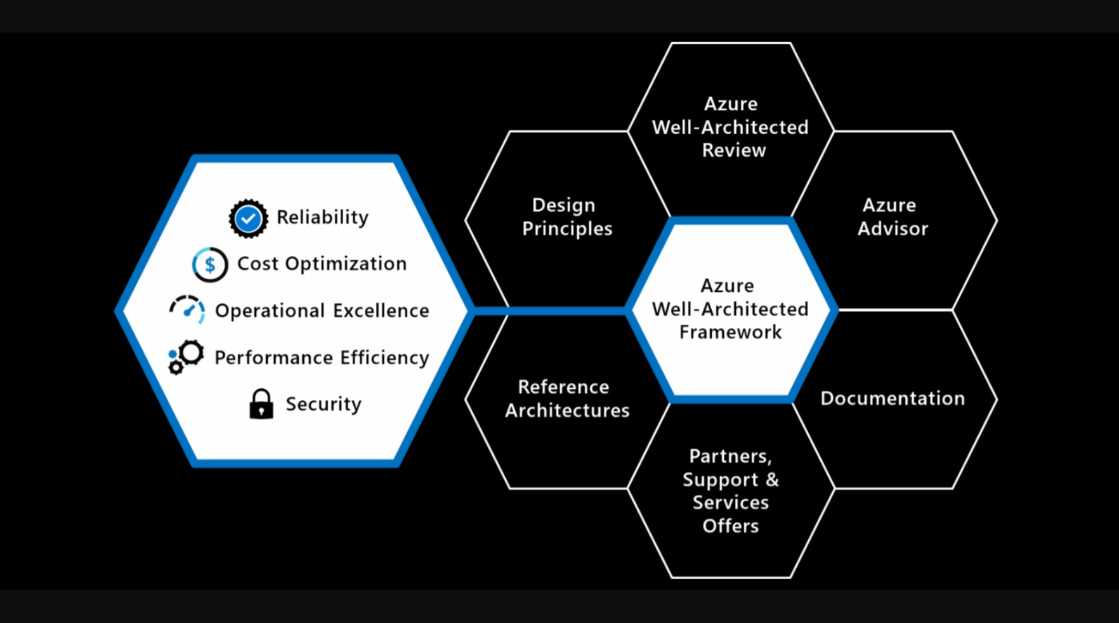

Slide 7
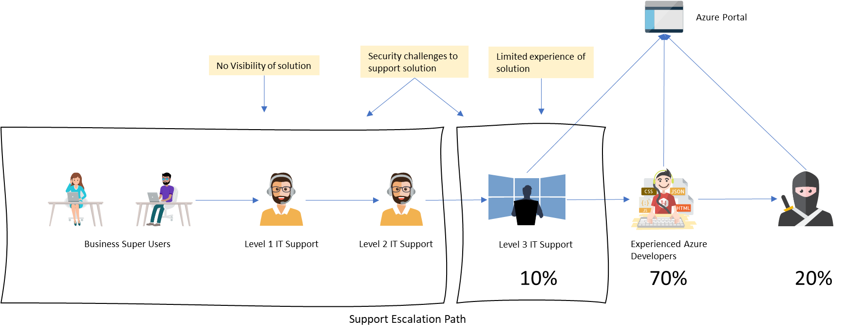
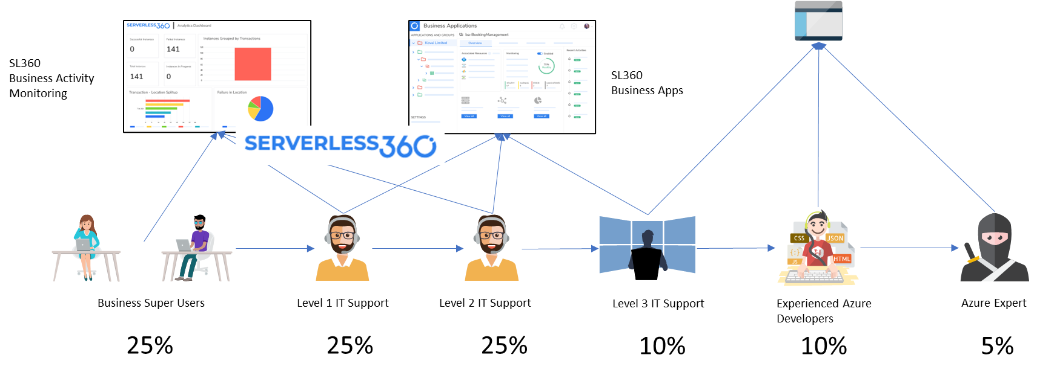
Excellence in Azure Operations
Typical Support
Serverless360 complements the Azure Portal by providing:
Advanced Observability of the complex integrations
End-to-end message visibility using distributed tracing
Deep integrated tooling for remediation
Cost Control
Desired Support
CHALLENGE
OBSERVATION
IDEAL SOLUTION
Azure portal is powerful for building enterprise-grade solutions but complex to manage and monitor; invites Azure experts to take up support tasks resulting in:
Elevated Total Cost of Ownership
Longer Resolution Time
90% of issues in production are functional/ data errors that can be safely offloaded to Support/ Business Users
Further, 60% of them can be automated for remediation
Lack of Observability and tooling for remediation is to be addressed
Enable support team with Serverless360 to Shift Left Support & allow Azure team to innovate, leading to:
Reduced Total Cost of Ownership
Improved Resolution Time
Ensure high CSAT
#AzConfDev

Slide 8
Scenario 1- Car Appointments
The business users log a request to get their car a maintenance appointment in the car appointments system
Each day a background processor will extract the appointments from the car appointments system and create a batch file which is sent to the Garage over SFTP
The garage fixes the cars
The garage sends batch files back with confirmations that appointments have been completed
The response batch items are loaded to the car appointments system

Slide 9
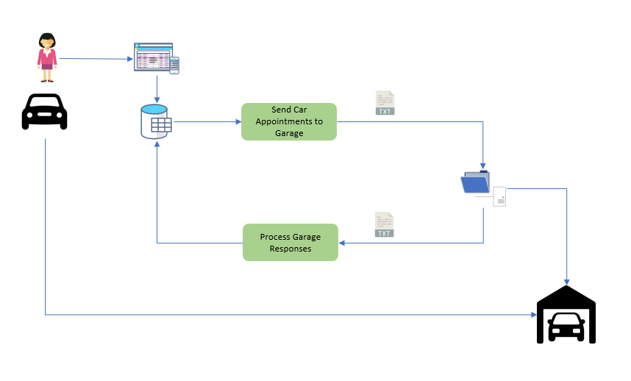
Car Appointments System- Logical View

Slide 10
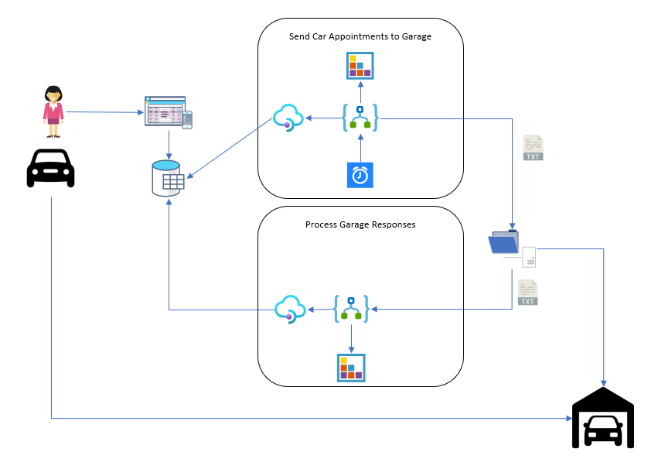
Car Appointments System- Implementation

Slide 11
Scenario 2- Finance System
The finance team uses SAP
IDocs are published from SAP to support multiple outbound integration scenarios
We need to receive IDOCS from SAP and implement a pub/sub pattern to drive other interfaces which will integrate data with different systems
We need to use MATMAS and ORDERS05 messages to integrate with Maximo

Slide 12
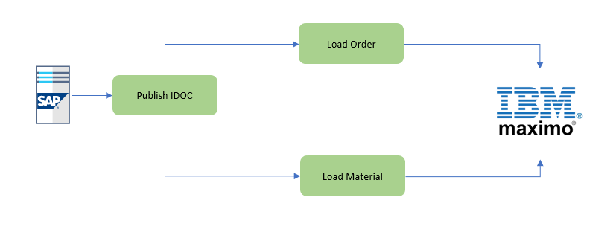
Finance System- Logical View

Slide 13
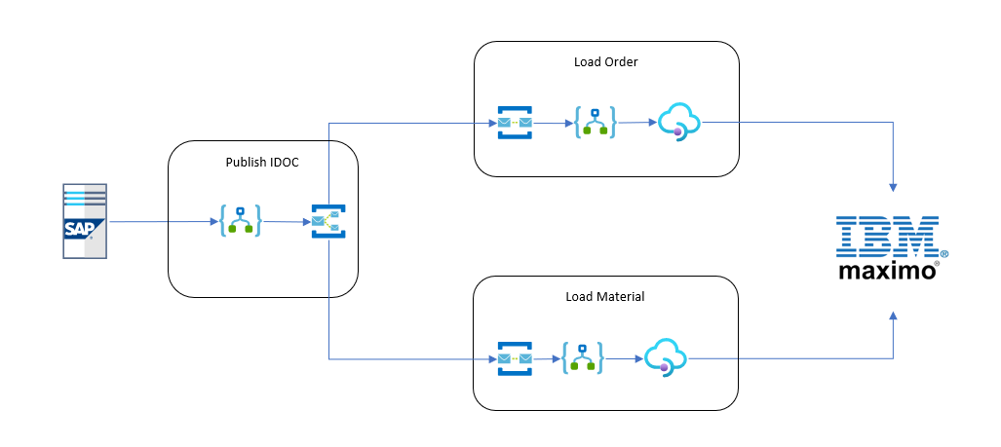
Finance System- Implementation

Slide 14
Scenario 3- IT Helpdesk Application
Kovai has multiple branch offices which all need to send data to the head office at the end of the day.
Each day the branch office submits data to an SFTP server which is then archived into a data lake so that we can use Power BI to build reports on the local branch office data.

Slide 15
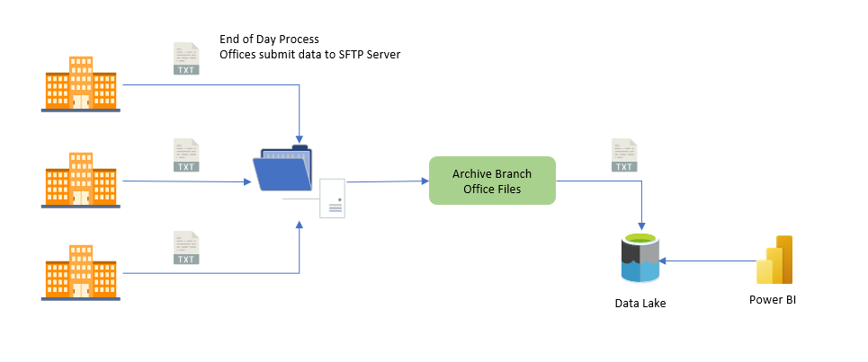
IT Helpdesk- Logical View

Slide 16
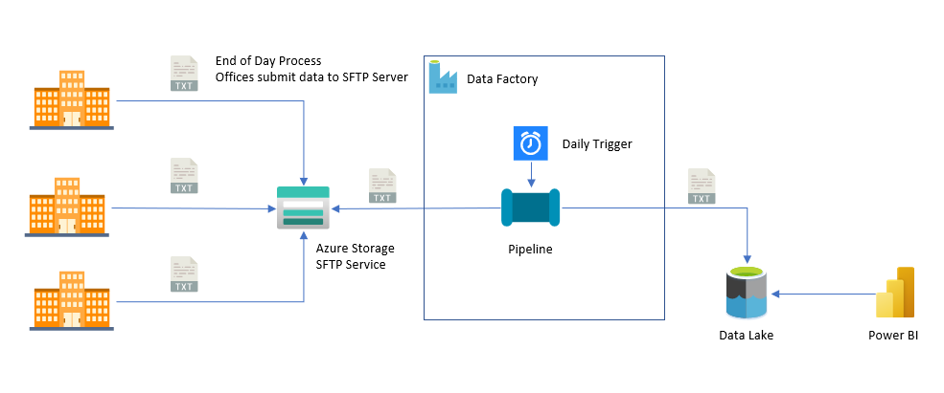
IT Helpdesk- Implementation

Slide 17

Azure Integration Demos
https://serverless360-demo-environment.document360.io/docs

Slide 18

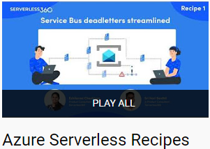




Also check:

Slide 19

Platinum Partner

Slide 20
Q & A

Slide 21


THANK YOU!
The Power of Azure Enterprise Integration
Ezhilarasi Chezhiyan
Lead Product Consultant | Serverless360 | Kovai.co | MCT | MCSA | MCSD
@ezhilarasikesav Ezhilarasi Chezhiyan

